Slide 1





Work and play for nomad children
NIDHISH RAGAV A
L PRAJAN
E NAVEEN
RT NANDHA KISHORE

Slide 2






KEYWORDS BY SORTING AND AFFINITY LINKS
MODERN EDUCATIONAL APPROACHES
Play based learning
Interactive learning
educational technology
Digital Learning
COMMUNITY INTEGRATION
Community Engagement
Cultural Adaption
Potential Environment
Inclusive Education
ENVIRONMENT ADAPTATION
Remote Education
Travelling teachers
Mobile Classroom
Flexible Curriculum
Nomadic Learning
COMPREHENSIVE LEARNING
STEM Education
Skill Development
Holistic Development
Life-long Learning

Slide 3





MINDMAPPING
Learning Games
Interactive Learning
Digital Learning Tools
Cultural Adaptation
Community Engagement
Enclusive Education
Holistic Development
Skill Developement
Stem Education
Nomadic Learning
Flexible Curiculum
Remote Teachers
vjnfvjfdn

Slide 4
MATRIX TABLE
CATEGO-RIES | USER-CENTERED DESIGN | LEARNING AWARENESS AND SUPPORT | INNOVATIVE SOLUTION | DATA AND ACCESSIBILITY
WHO | Nomad children, Education specialists | Nomadic children, families, educators, community leaders | Nomadic children, families, local elders, cultural leaders | Nomad children, Educators, Family, Parent, Community
WHAT | Blended learning, Project based learning, experiential learning | Flexible curriculum, Portable materials, Adaptive schedules | Local languages, Traditional craft, stories, cultural Projects | Curriculum containing academic life skills and social development
WHY | To Provide engaging, relevant education | To ensure Accessibility and effectiveness | To respect and integrate cultural Identity | To Provide Holistic education
WHEN | Continuously from Initial Phase | Throughout the Project with ongoing adjustments | Throughout the Project starting from Planning | Continuously focusing on immediate and long-term outcomes
WHERE | Mobile classrooms, community centers, Online Platforms | Nomadic communities considering mobility and Resources | Nomadic communities | Across all nomadic living Areas
HOW | Digital tools, Interactive methods, hands on activities, training educators | Transportable modules integrating local cultural, community sites | Community engagement, Cultural studies, festival story telling | Balanced Program, life skill workshop, counseling and regular assessment

Slide 5
USER PARTICIPANT MAPPING
Advocacy groups
TERTIARY LEVEL
Enviroinmental educators
Local government
PRIMARY LEVEL
Policy makers
Mobile edu
LEARN/PLAY FOR NOMAD CHILDREN
Technical
edu
SECONDARY LEVEL
Play activities
Educational workers
QUATERNARY LEVEL
Researchers

Slide 6
CONTEXTUAL INQUARY

Slide 7
QUESTIONNAIRES AND CUE CARDS
User Feedback Questionnaire for education for nomadic children
 | 1 Inadequate | 2 Fair | 3 Good | 4 Very Good | 5 Exceptional
1. How easy is it to navigate the app? |  | √
2. How helpful are the resources and tools provided in the app? |  |  |  | √
3. How satisfied are you with the educational resources and features? |  |  |  | √
CUE – CARDS
Cultural learning How do you combine Western and local studies? Crisis Management: What strategies do you use for managing student analysis? Student Assessment: What are the key components of a comprehensive student assessment? Subject Plans: How do you develop and customize lesson plans for your patients? Integrated learning: How do you approach subjects for students by integrated learning/playing

Slide 8







ACTIVITY MAPPING
USER JOURNEY MAPPING
User action
Consideration
Decision
This Photo by Unknown Author is licensed under CC BY-SA
Retention
Feedback and support
Engagement
This Photo by Unknown Author is licensed under CC BY-SA-NC
Onboarding

Slide 9


PERSONAS AND OIOR TABLE
Sarah(child)
Sarah uses the app to explore new subjects and connect with friends while traveling. The app’s educational games and group challenges provide a fun way to learn and stay engaged with peers, even on the move.
Dave (Elderly Grandparent)
Usage: Dave uses the app to help his grandson learn and play interactive brain games that keep him sharp. The storytelling feature allows him to pass on knowledge, while the brain games help maintain his cognitive health.
OIOR TABLE
Observation | Inference | Opportunity | Recommendation
Enhance knowledge in various subjects . | . Interactive and gamified learning increase their curiosity. | Organize community play events and outdoor activities | Invest in portable devices like tablets or laptops with pre-installed educational software.
Develop critical thinking and problem-solving skills | Social interactions and activities enhance their social skill | creative play kits that can be easily transported | Ensure consistent internet access through mobile hotspots
Foster a love for learning | Physical activity and creative play are crucial for the overall health | mobile-friendly educational apps for needs of children | Encourage participation in online platforms for group activities

Slide 10





IDEATION PART - ONE
LEARN / PLAY
FOR NOMAD CHILDREN

Slide 11
CONTINUATION
SCAMPER for Learning and Play for Nomad Children
Substitute: Replace traditional classroom learning with mobile learning modules and interactive educational games accessible on smartphones and tablets. This ensures that nomad children can continue their education regardless of their location.
Combine: Integrate learning tools, such as language and math games, with recreational activities within a single app. This combination makes learning fun and engaging, encouraging children to spend more time on educational activities.
Adapt: Apply features from fitness tracking apps to monitor and encourage daily learning activities and physical play. For example, track the number of new words learned or the time spent on educational games, similar to how fitness apps track steps and exercise.
Modify: Redesign the app interface to be more child-friendly and visually appealing. Using bright colors, playful characters, and intuitive navigation will make the app more engaging for young users.
Put to Another Use: Utilize virtual classrooms and online peer interaction to create a community for nomad children. This can help them feel connected and supported by peers who share similar lifestyles and challenges.
Eliminate: Remove barriers to access, such as the need for high-speed internet and complex registration processes. Offer offline learning options and simple, straightforward sign-up processes to ensure all children can use the app easily.
Reverse: Shift the focus from purely academic content to a balance of learning and play. Encourage children to take breaks and participate in physical activities, promoting overall well-being and preventing burnout.
.
Lateral Thinking for Learning and Play for Nomad Children
Reframe the Problem
Shift the focus from traditional learning to integrated learning and play. Implement daily check-ins that track both educational progress and play activities. This ensures a balanced approach, promoting cognitive development and well-being through regular, structured interaction.
Cross-Pollinate Ideas
Incorporate gamification techniques from fitness apps to make learning fun and engaging. Use rewards and milestones to motivate children to complete educational activities and participate in games. By making learning playful and interactive, children are more likely to stay engaged and enthusiastic about their education.
Break Assumptions
Challenge the traditional need for long study sessions by offering micro-learning modules and quick educational games. Short, frequent learning sessions can be more effective for maintaining attention and retention. On-demand access to educational content ensures that children can learn at their own pace and according to their unique schedules.
Challenge the Status Quo
Create a system for instant access to educational resources and support via mobile devices. This includes virtual tutors, interactive lessons, and educational games that can be accessed anytime, anywhere. By bypassing traditional classroom settings, children can receive continuous education and play opportunities, tailored to their nomadic lifestyle.

Slide 12
IDEATION PART - TWO
Synectic
Application: Encourage creative thinking to design unique solutions for educational and recreational challenges faced by nomad children. For example, consider unexpected user interactions or combine unrelated educational resources, such as integrating learning modules with interactive storytelling. This approach ensures that the app remains engaging and adapts to the dynamic lifestyle of nomad children.
Analogical Thinking
Application: Use analogies from other industries, such as fitness tracking apps, to create novel learning tools. For instance, integrate gamification into educational activities or create a "learning tracker" to visualize academic progress and milestones. This approach makes learning fun and motivates children to engage consistently with educational content.
Concept Evaluation
Application: Evaluate proposed app features, such as interactive learning modules and educational games, by testing user feedback. Assess how well these features meet the needs of nomad children, improve accessibility, and align with the goals of providing an engaging and supportive learning environment. Regular evaluation ensures that the app remains relevant and effective in meeting the unique needs of nomad children.

Slide 13
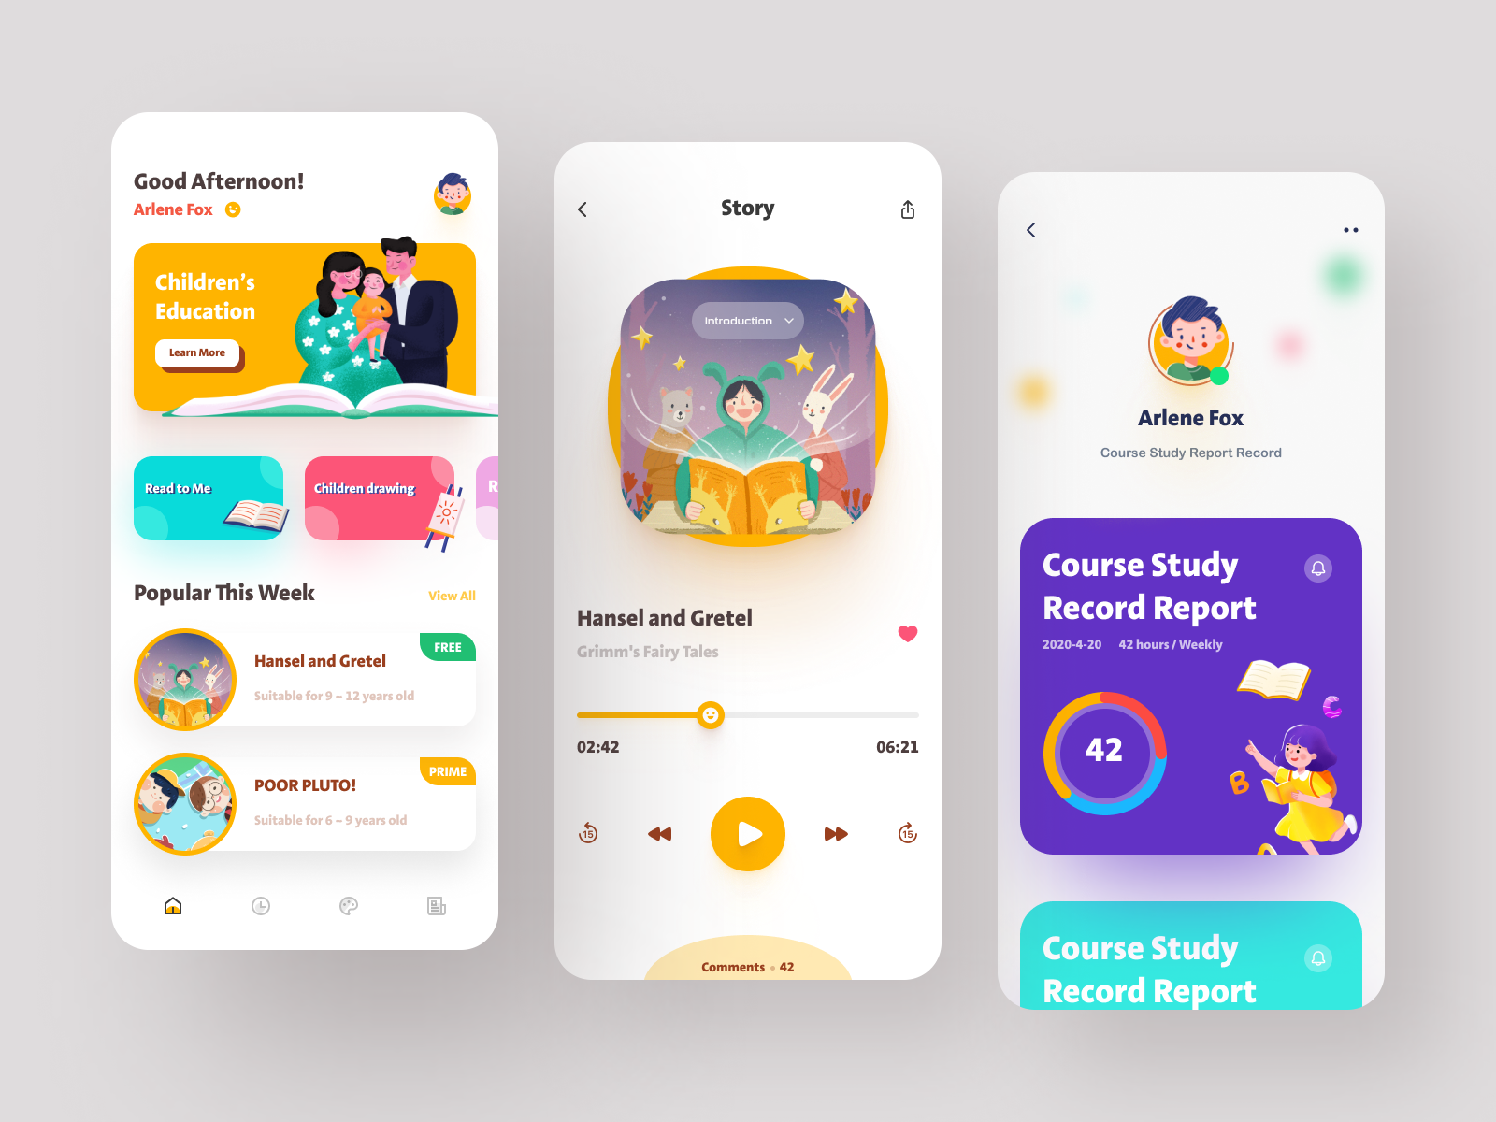
SOFT PROTOTYPE
Stories and games
DASH-
BOARD
HOME
SCREEN
Curriculum
STATISTICS
Lessons

Slide 14
MEDIUM PROTOTYPE
.
POC (Proof of Concept)
Definition: A prototype or demo built to validate that the core functionality works and the app’s concept is viable.
Purpose:
Test the feasibility of integrating real-time mood tracking and therapist interaction.
Validate the value of providing immediate access to crisis support.
MVP(Minimum Viable Product)
Definition: The most basic version of the app that includes only the essential features needed to solve the primary problem.
Key Features: learning Tracker: Basic slider to track study and notes. Daily Tips: Simple goals reminders.
XD (Experience Design)
Definition: The overall feel of the app, ensuring it’s engaging, user-friendly, and accessible.
Key Aspects:
Usability: Simple, intuitive UI with clear calls to action (e.g., “Add goal”, “audio stories/lessons”).
Emotional Engagement: Calming colors
IA (Information Architecture)
Definition: The structural design of the app’s content and information flow.
Components:
Navigation Structure: Clear, intuitive navigation with easy access to key sections (Dashboard, study Tracker, Query Support, Lessons Directory).

Slide 15







PROTOTYPE
MHC
interface
LOGIN
SETTINGS
HOME
LESSONS AND GAMES
LOGOUT
TESTS
SUPPORT

Slide 16

USABILITY STUDIES, FEEDBACK
Usability studies
Objective
Evaluate the ease of use and effectiveness of key app features (Learning Tracker, Game Booking, Emergency Support).
Method
User testing with 10-15 participants, performing tasks like logging learning activities, booking games, and accessing help.
User Feedback
Positive:
Easy Learning Tracking: Users found the learning activity slider intuitive and simple.
Engaging Design: The app’s colorful, playful interface was appreciated.
Emergency Access: The Emergency Support button was easy to find and reassuring.
Improvements:
Game Booking: Some users struggled with game search filters.
Personalization: Users wanted more control over learning triggers (e.g., "New Environment Stress").
Onboarding: A clearer introduction to app features was suggested.

Slide 17
CREATING BUSINESS MODEL
SWOT Analysis
Strengths | Weekenesses
Easy-to-use design | Requires stable connectivity.
Downloadable content. | High storage requirement.
Combines education and games. | High storage requirement.
Opportunities | Threats
Benefit various regions. | Resistance to new tech.
Integrate AR. | Diverse interests and needs.
Expansion into global markets | Robust measures are needed.

Slide 18
SOAR -- ANALYSIS
Strengths | opportunities
accessible anytime and anywhere, catering to the nomadic lifestyle | Leveraging advancements in mobile technology and AI can enhance the app’s capabilities, providing more personalized and effective learning experiences.
making learning and playing enjoyable. motivating. | Potential for AI-based personalization
Aspirations | Result
Become a leading mental health app globally | Improve user well-being and engagement
Continuously evolve and offer updated concepts | Increase user retention and satisfaction
Further Study and Research
Competitor Analysis
Study educational apps like Khan Academy Kids and Duolingo to identify effective features and areas for differentiation.
User Feedback
Regularly gather user feedback to improve features and usability.
Data Privacy
Ensure GDPR and COPPA compliance to protect sensitive information.

Slide 19
FULL REFERENCE AND ACKNOWLEDGEMENT
Dyer, C. (2016)
Title: Evolving approaches to educating children from nomadic communities
Available at: https://doi.org/10.1007/s11125-016-9381-6
Knight, B.G., Lee, L. (2007)
Title: Encyclopedia of Gerontology (Second Edition)
Pages: 41-49
Available at: https://doi.org/10.1016/B0-12-370870-2/00007-X
Outdoor Learning and Play: Pedagogical Practices and Children’s Development (2022)
Available at: https://doi.org/10.1007/978-3-030-72595-2
Acknowledgement
1)Mrs.Murugavalli – department of AI
KRCT - Samayapuram

